Slide 1




HOPE TO SKILL
Lecture 41
LangChain Expression
Language
Artificial Intelligence Advance Course

Slide 2





AI INSTRUCTORS
Dr.Irfan Malik
Dr.Sheraz Naseer
Hassan Mahmood
Ramsha Imran
M.Haris Tariq

Slide 3


Previous Lecture Topics
01
Retrievals
02
Practical Implementation

Slide 4
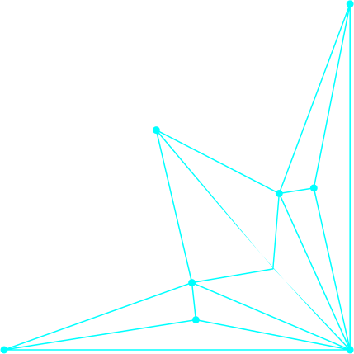


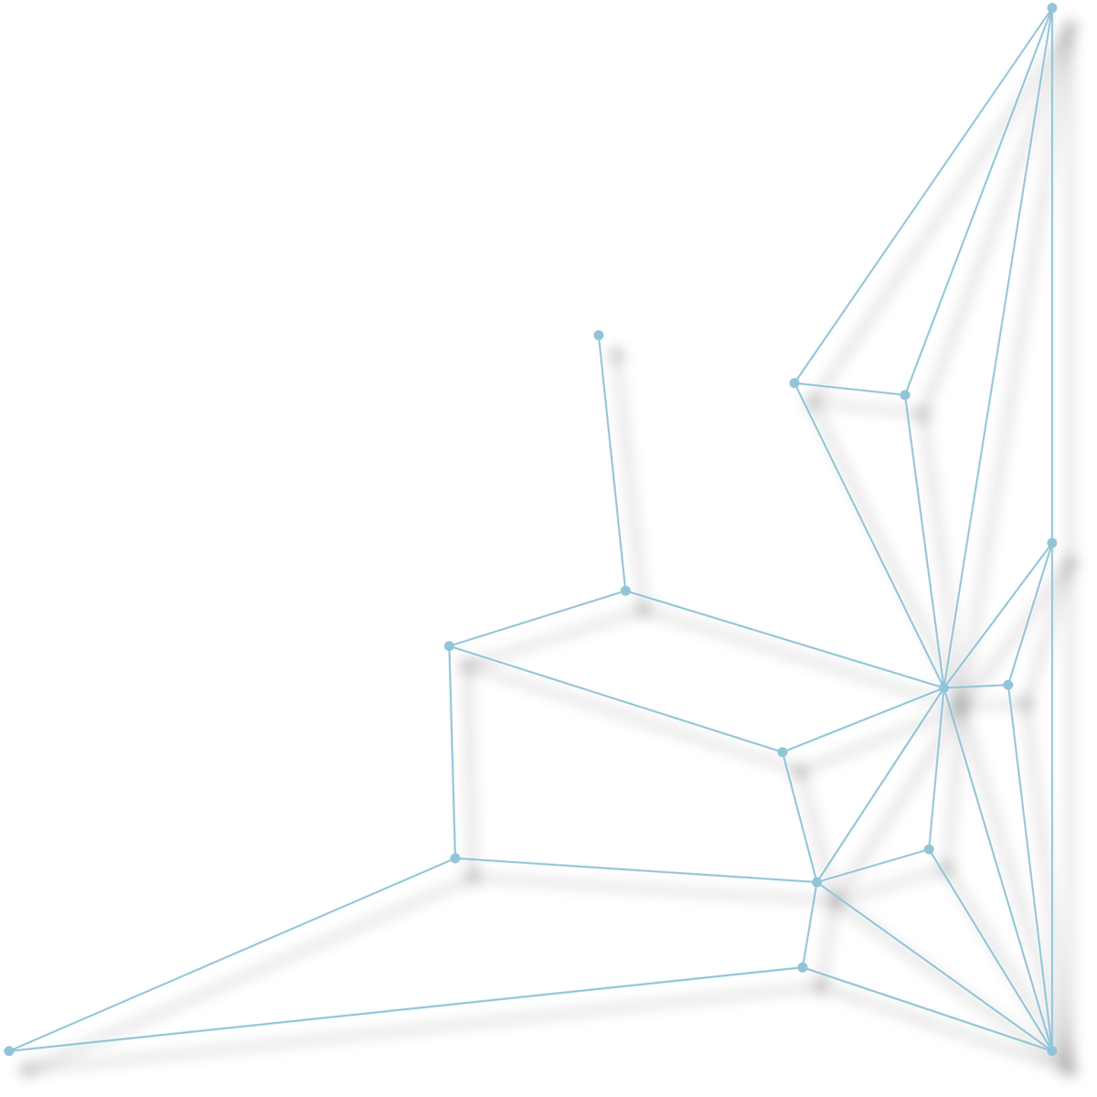
Outline
Brief description of LCEL
Key components involved

Slide 5
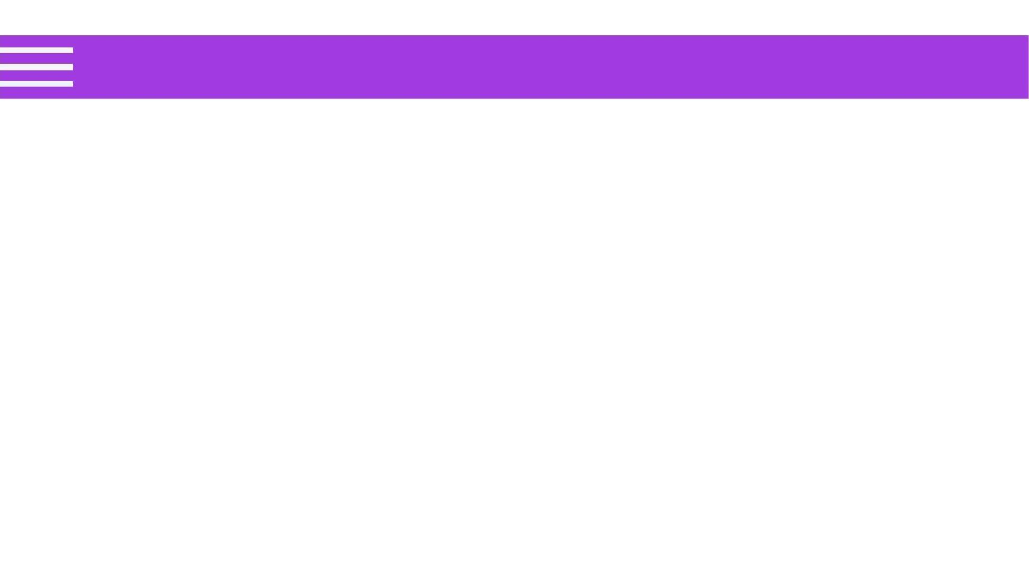
LCEL
Definition:
A standard interface in LangChain that allows for the creation and execution of custom chains. Runnables can be invoked, batched, streamed, and transformed.
Example:
stream: Streams chunks of a response.
invoke: Calls the chain on an input.
batch: Calls the chain on for multiple inputs.

Slide 6
Runnable Sequence
Definition:
A composition of multiple runnables invoked sequentially,
where the output of one serves as the input to the next.
sequence = RunnableLambda(lambda x: x + 1) |
RunnableLambda(lambda x: x * 2)
result = sequence.invoke(5) # Returns (5 + 1) * 2 = 12

Slide 7
Runnable Parallel
Definition:
A composition that invokes multiple runnables concurrently,
providing the same input to each.
from langchain_core.runnables import RunnableParallel
parallel = RunnableParallel({"double": RunnableLambda(lambda x: x *
2), "triple": RunnableLambda(lambda x: x * 3)})
results = parallel.invoke(5)
# Returns {'double':10, 'triple':15}

Slide 8
Prompt Templates
Basic Prompt Template
A simple template that allows for dynamic input
replacement within a predefined string.
from langchain import PromptTemplate
template = "What is the capital of {country}?"
prompt_template = PromptTemplate(template=template)
prompt = prompt_template.format(country="France")
print(prompt) # Output: What is the capital of France?

Slide 9
Few-Shot Prompt Template
A template designed to provide a few examples to guide the model's responses, enhancing its understanding of the desired output.
from langchain import FewShotPromptTemplate
examples = [
{"query": "How are you?", "answer": "I can't complain."},
{"query": "What time is it?", "answer": "It's time to get a watch."}
]
example_template = "User: {query}\nAI: {answer}\n"
few_shot_template = FewShotPromptTemplate(examples=examples, example_template=example_template)
prompt = few_shot_template.format(query="What's your name?", answer="I'm an AI.")
print(prompt)

Slide 10
Chat Prompt Templates
A specialized template for chat models that formats a sequence of messages, allowing for distinct roles (e.g., human, AI).
from langchain.prompts import ChatPromptTemplate
chat_template = ChatPromptTemplate.from_messages([
("human", "What is the capital of {country}?"),
("ai", "The capital of {country} is {capital}.")
])
messages = chat_template.format_messages(country="Canada", capital="Ottawa")
print(messages)
# Output: [('human', 'What is the capital of Canada?'), ('ai', 'The capital of Canada is Ottawa.')]

Slide 11
Itemgetter
Itemgetter is often used to extract data from input maps, particularly when working with multiple inputs in chains.

Slide 12
Output Parsers
A component that processes outputs from AI models,
transforming them into a desired format or structure.
from langchain_core.output_parsers import StrOutputParser
parser = StrOutputParser()
parsed_output = parser.invoke("This is a test.") # Processes the string output

Slide 13
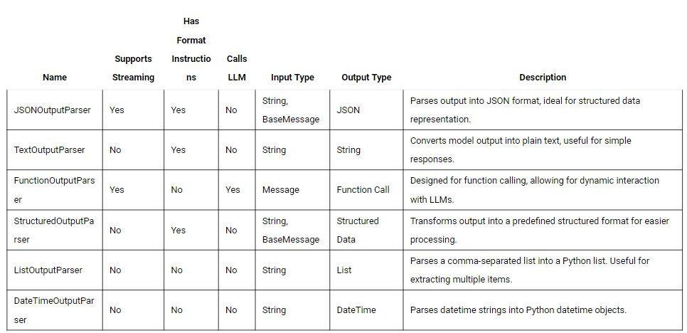

Slide 14

Demo

